Slide 1

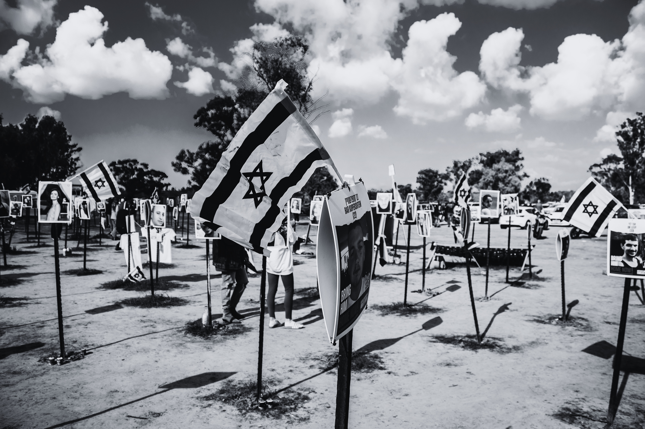
FACES OF THE FESTIVAL
THE NOVA MUSIC FESTIVAL MASSACRE

Slide 2
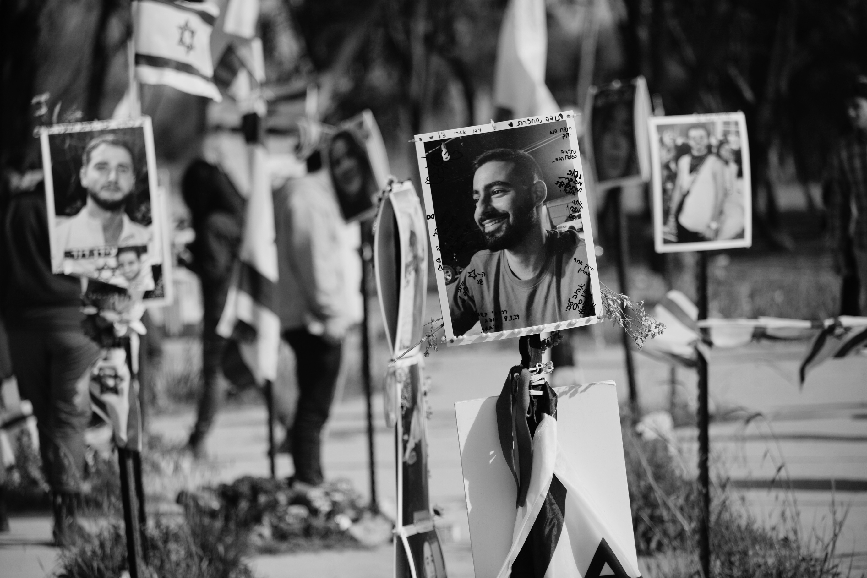
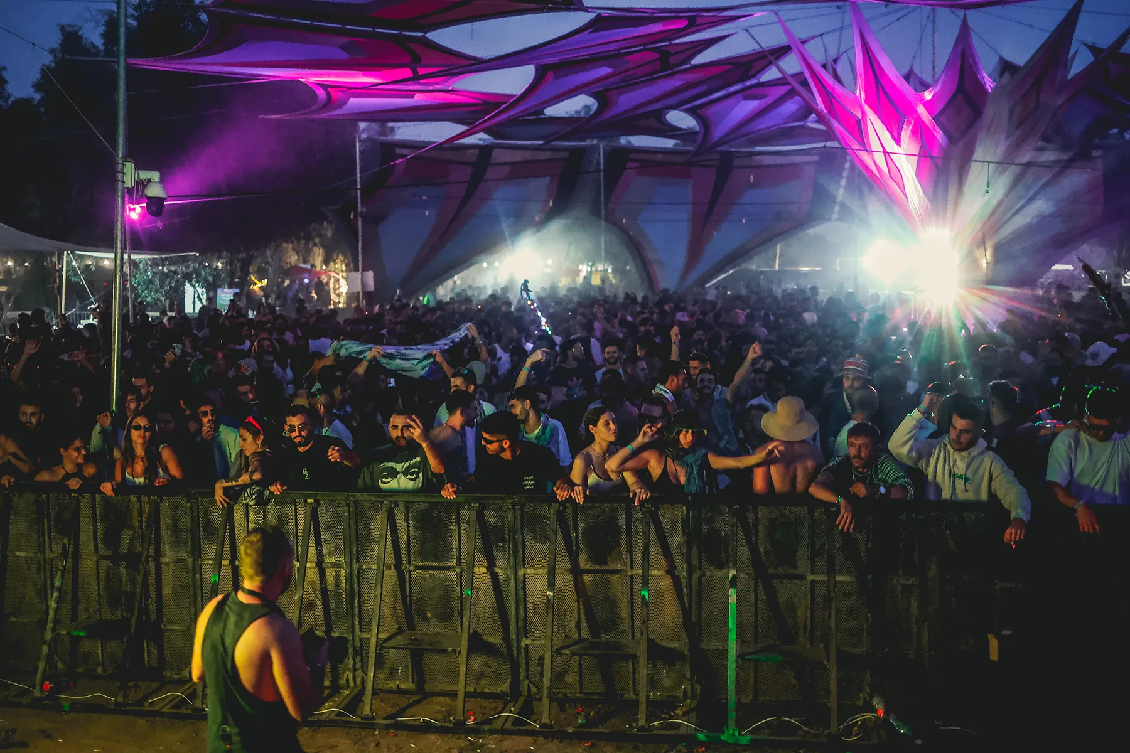

WHAT WAS NOVA?
FACES OF THE FESTIVAL
The Supernova Music Festival in Re’im, Israel was an electronic music festival in the Gaza envelope attended by 3,500-4,000 young people.
At 6:29 am terrorists began attacking the festival grounds, murdering hundreds of innocent party-goers and kidnapping over 40 to Gaza.

Slide 3
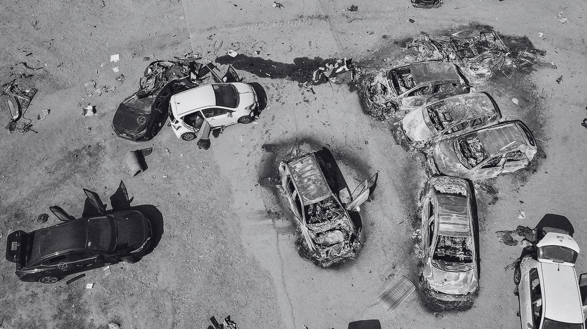

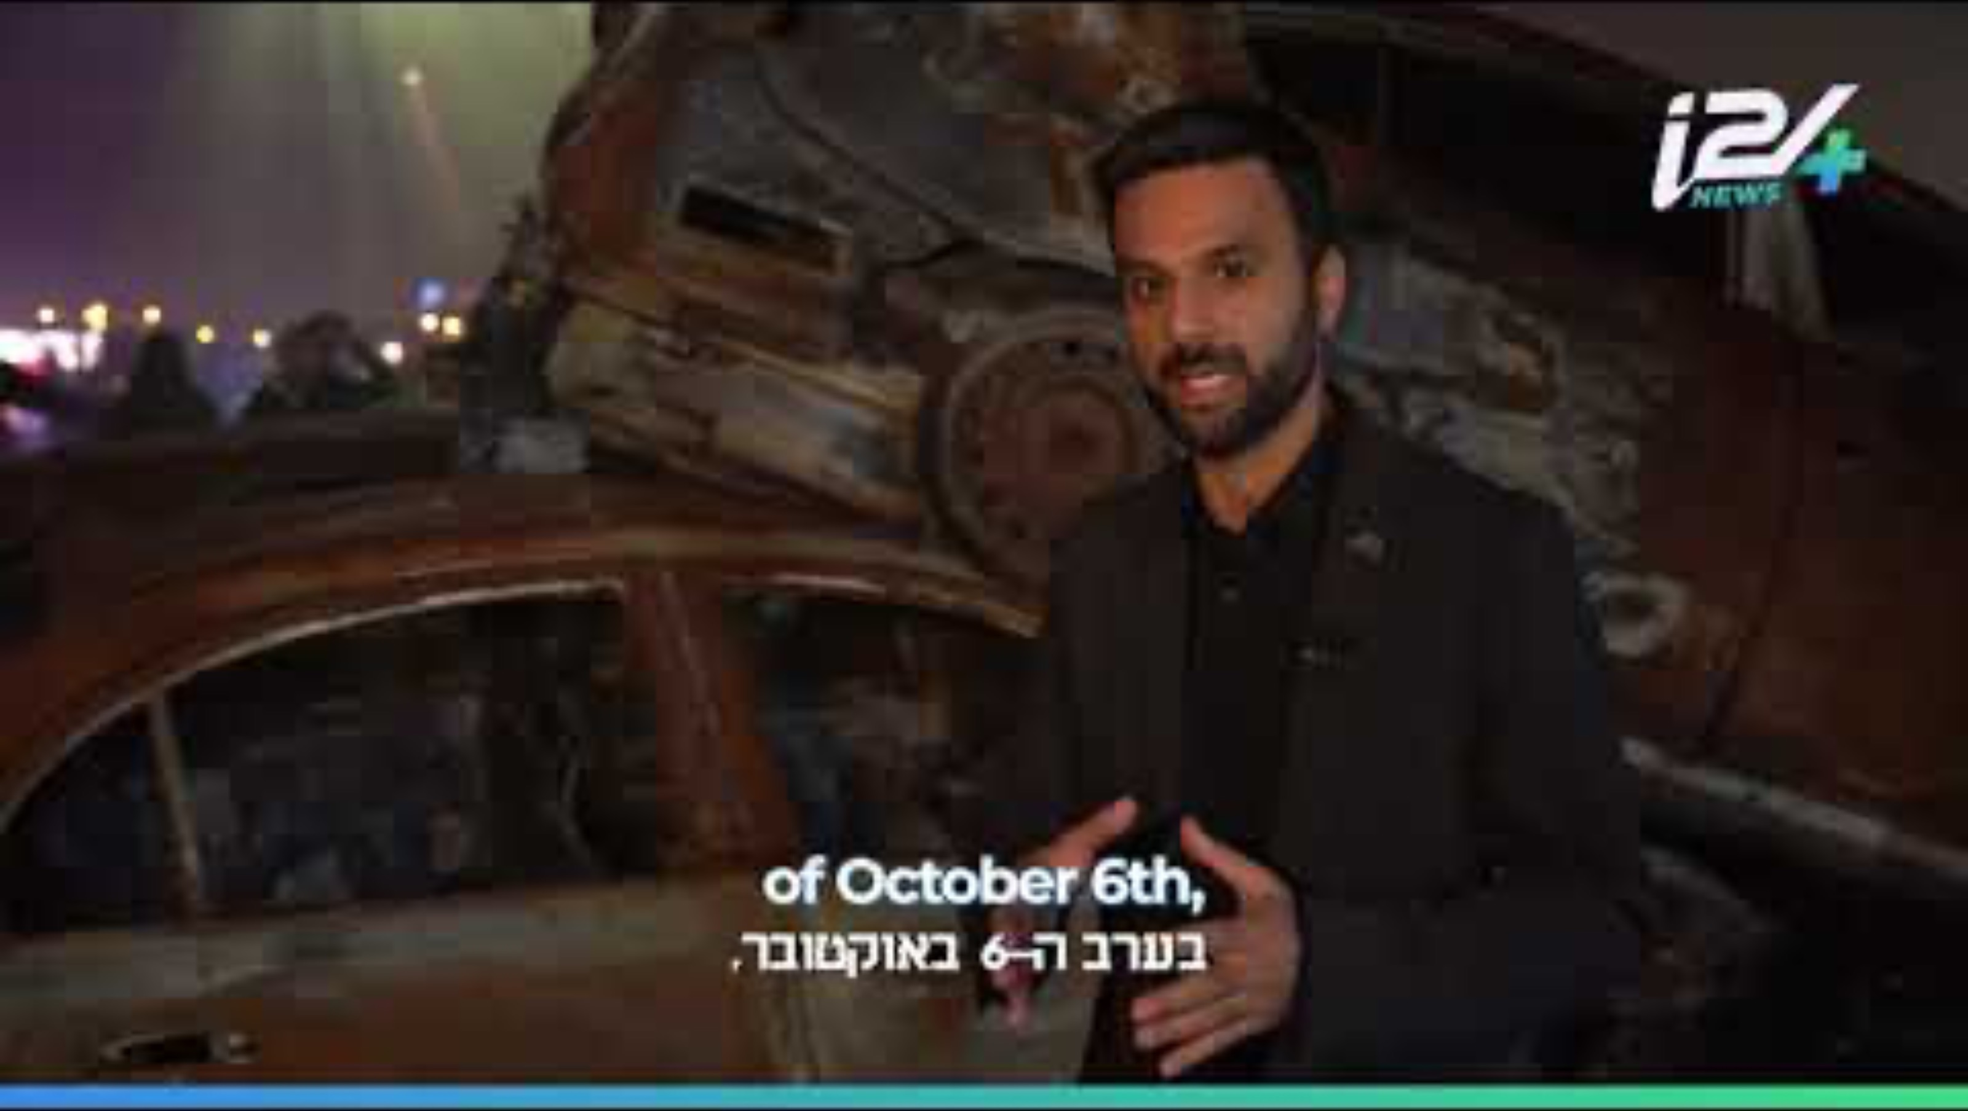
THE MASSACRE
FACES OF THE FESTIVAL
https://www.youtube.com/watch?v=7ktWeT9rUDM

Slide 4
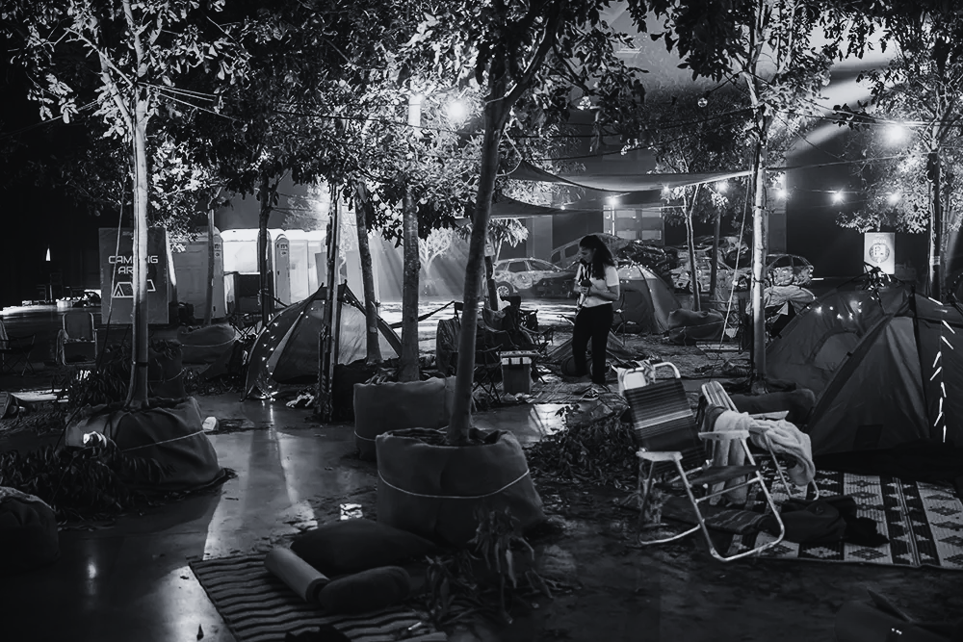
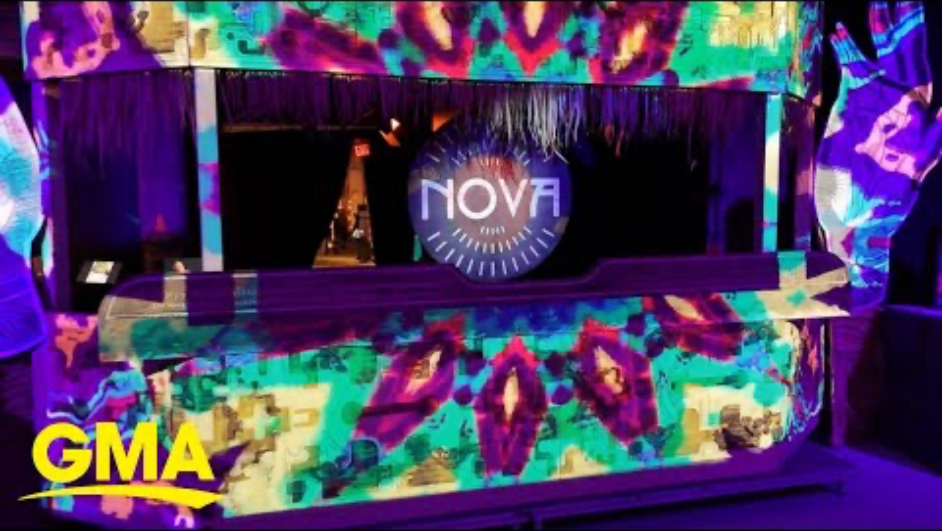
NOVA EXHIBIT
FACES OF THE FESTIVAL

Slide 5
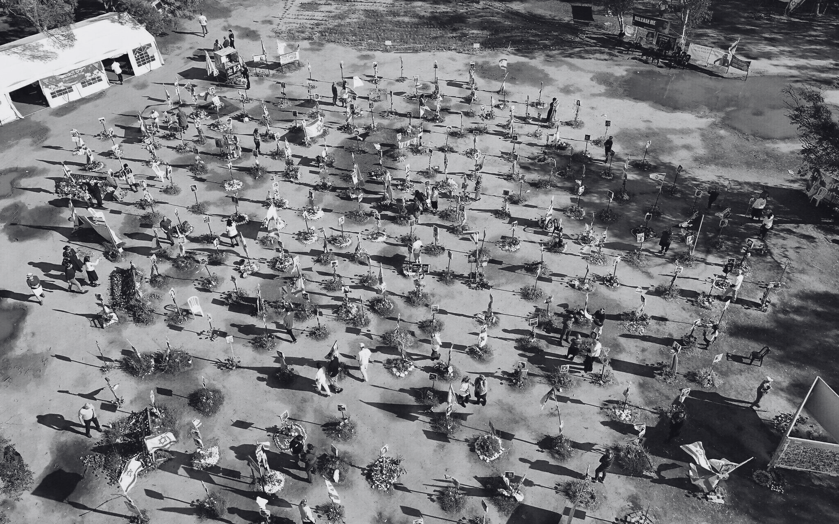
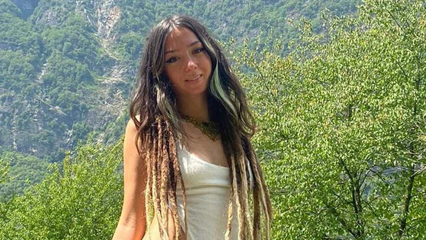
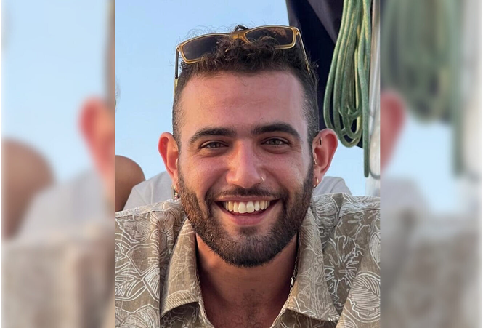
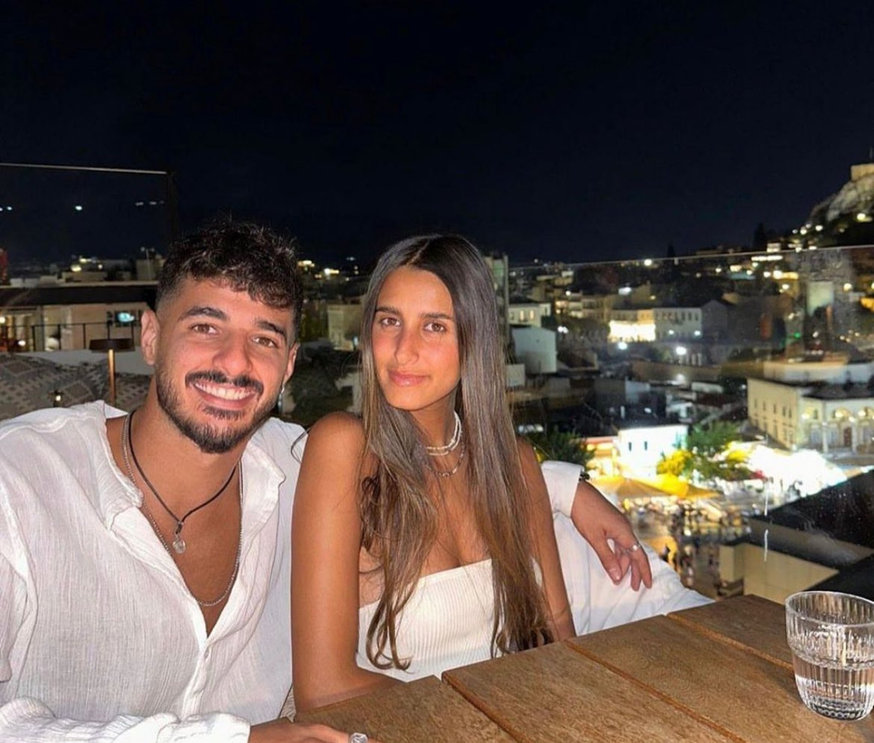
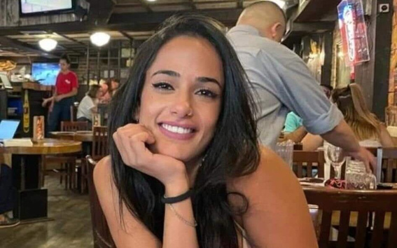
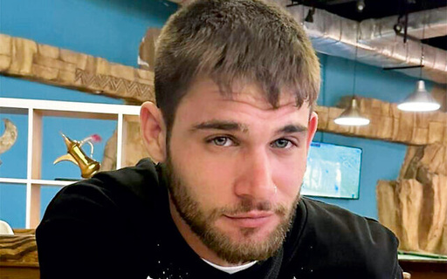
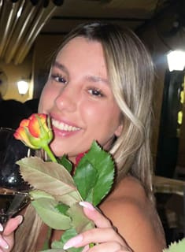
367 NOVA ATTENDEES MURDERED BY HAMAS
MORE THAN JUST NUMBERS
FACES OF THE FESTIVAL
Shani Louk
Lotan Abir
Shalev Madmoni
Tattoo artist
IDF soldier
Franchise manager
Noy Aviv
Dor Avitan
Eden Abdullayev
English Teacher
Singer and Songwriter
Waitress and Student
Singer and Songwriter

Slide 6
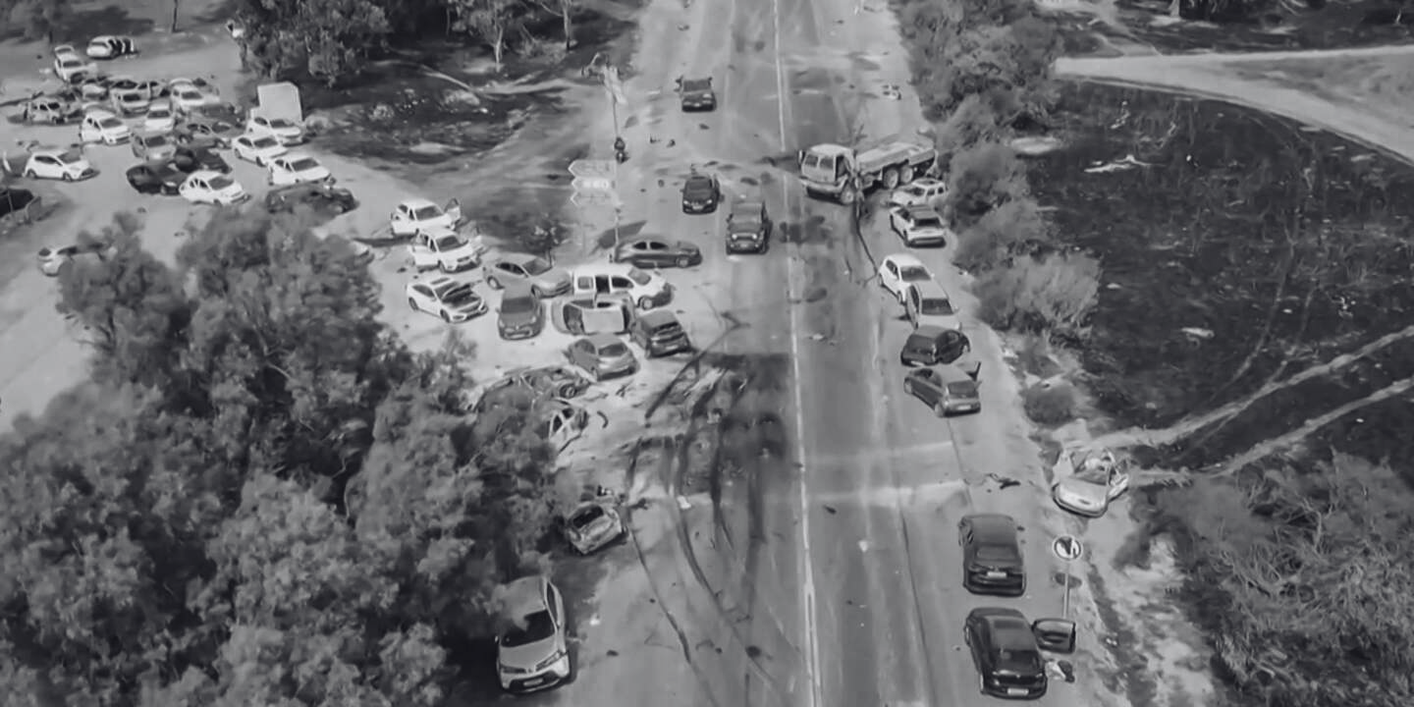
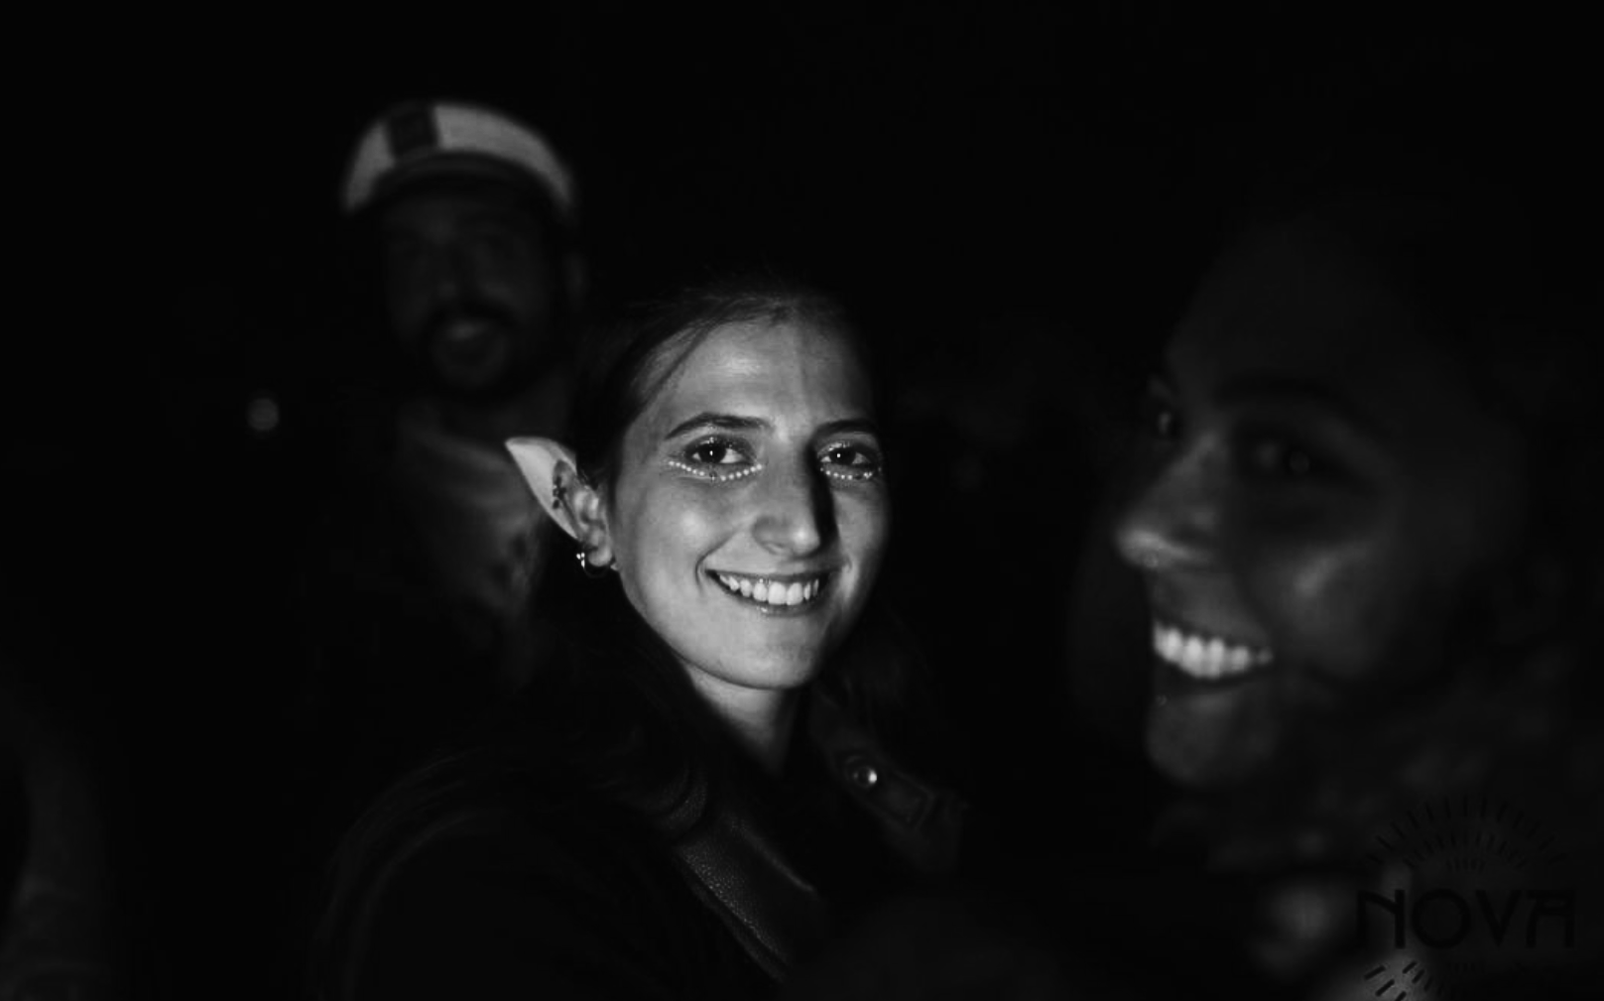
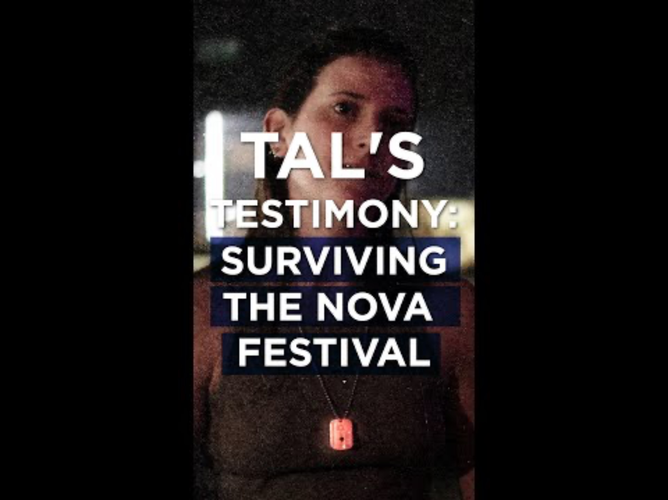
TAL’S TESTIMONY
“THE HARDEST DAY FOR ME WAS NOT THE 7TH OF OCTOBER, IT WAS THE 8TH. WHEN I STARTED REALIZING HOW MANY OF THE PEOPLE THAT I LOVE ARE DEAD.”
FACES OF THE FESTIVAL
Tal Shimony, October 7th survivor

Slide 7
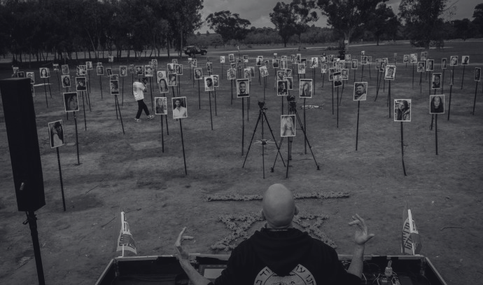
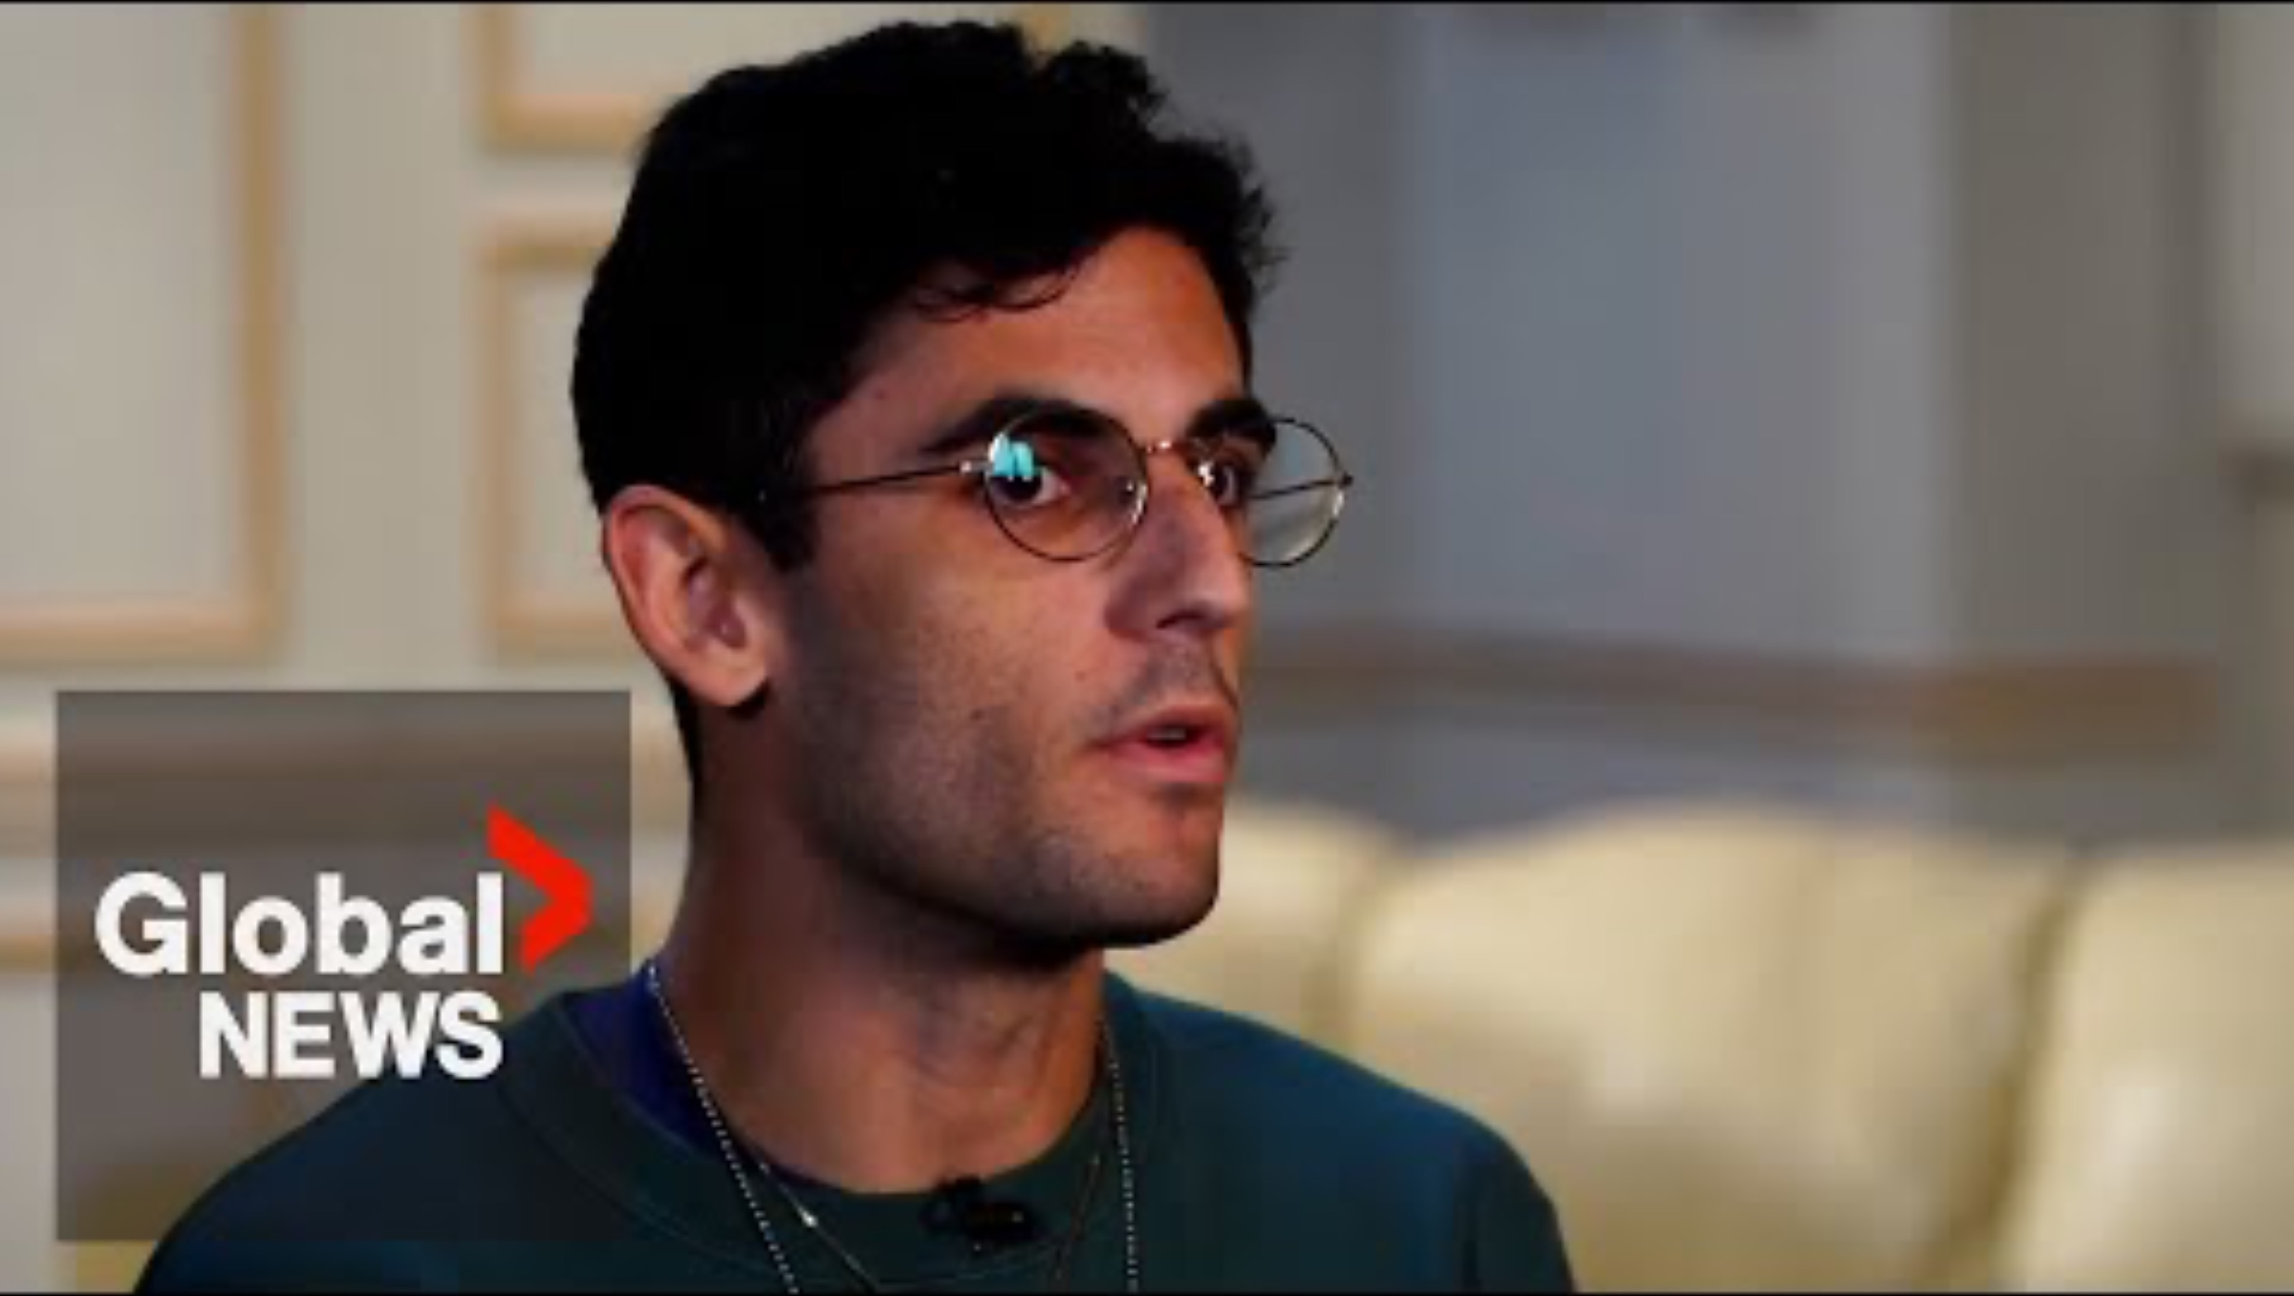
SHYE’S TESTIMONY
FACES OF THE FESTIVAL

Slide 8
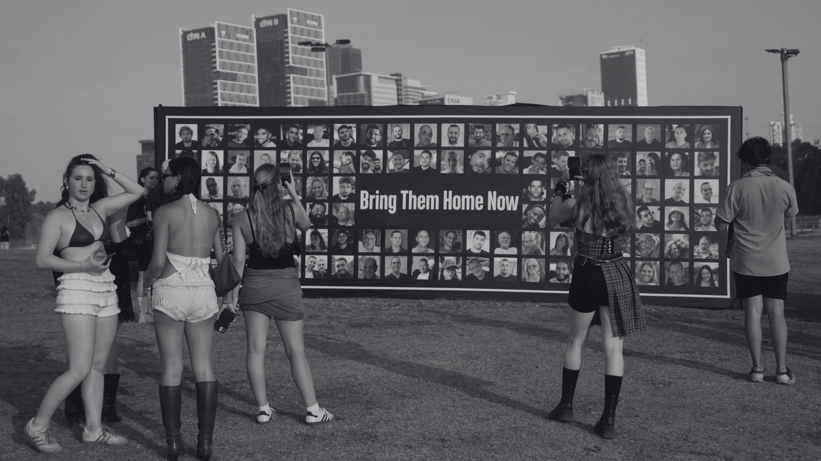
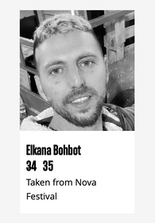
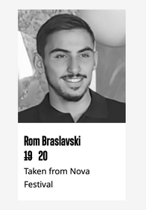
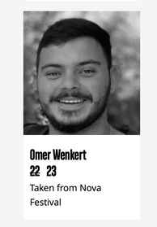
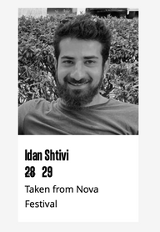
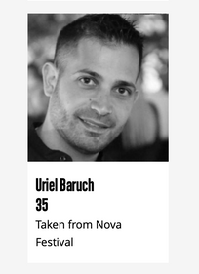
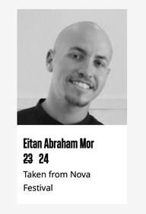
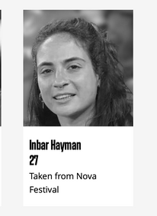
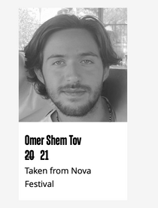
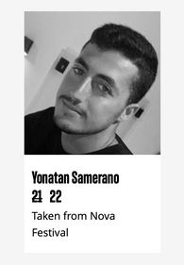
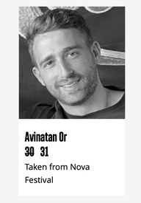
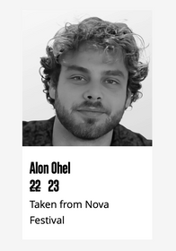
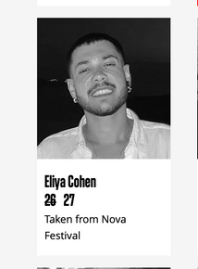
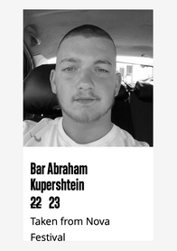
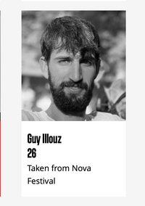
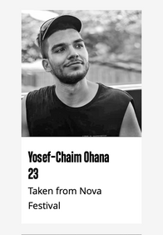
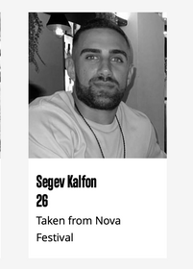
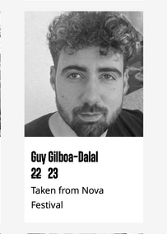
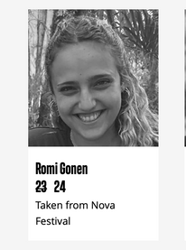
LET MY PEOPLE GO!
43 NOVA ATTENDEES WERE KIDNAPPED BY HAMAS AND TAKEN TO GAZA
FACES OF THE FESTIVAL

Slide 9
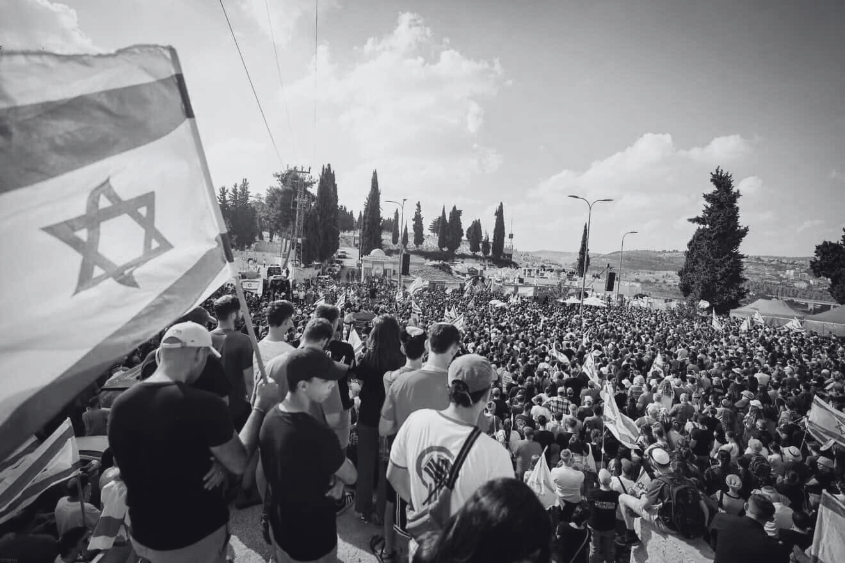
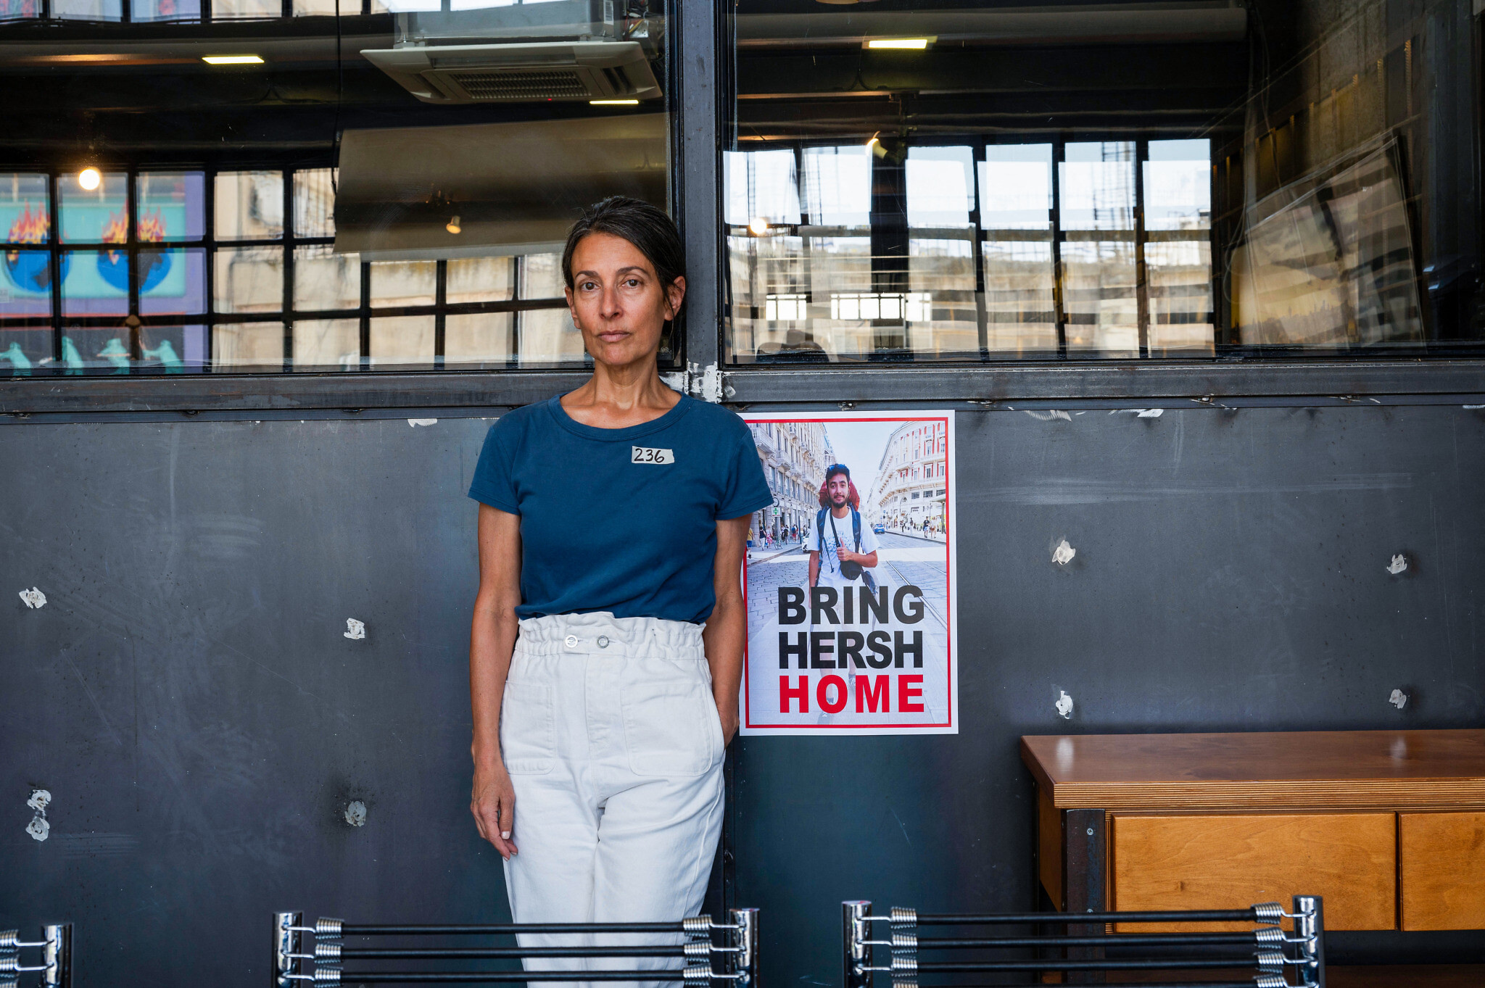
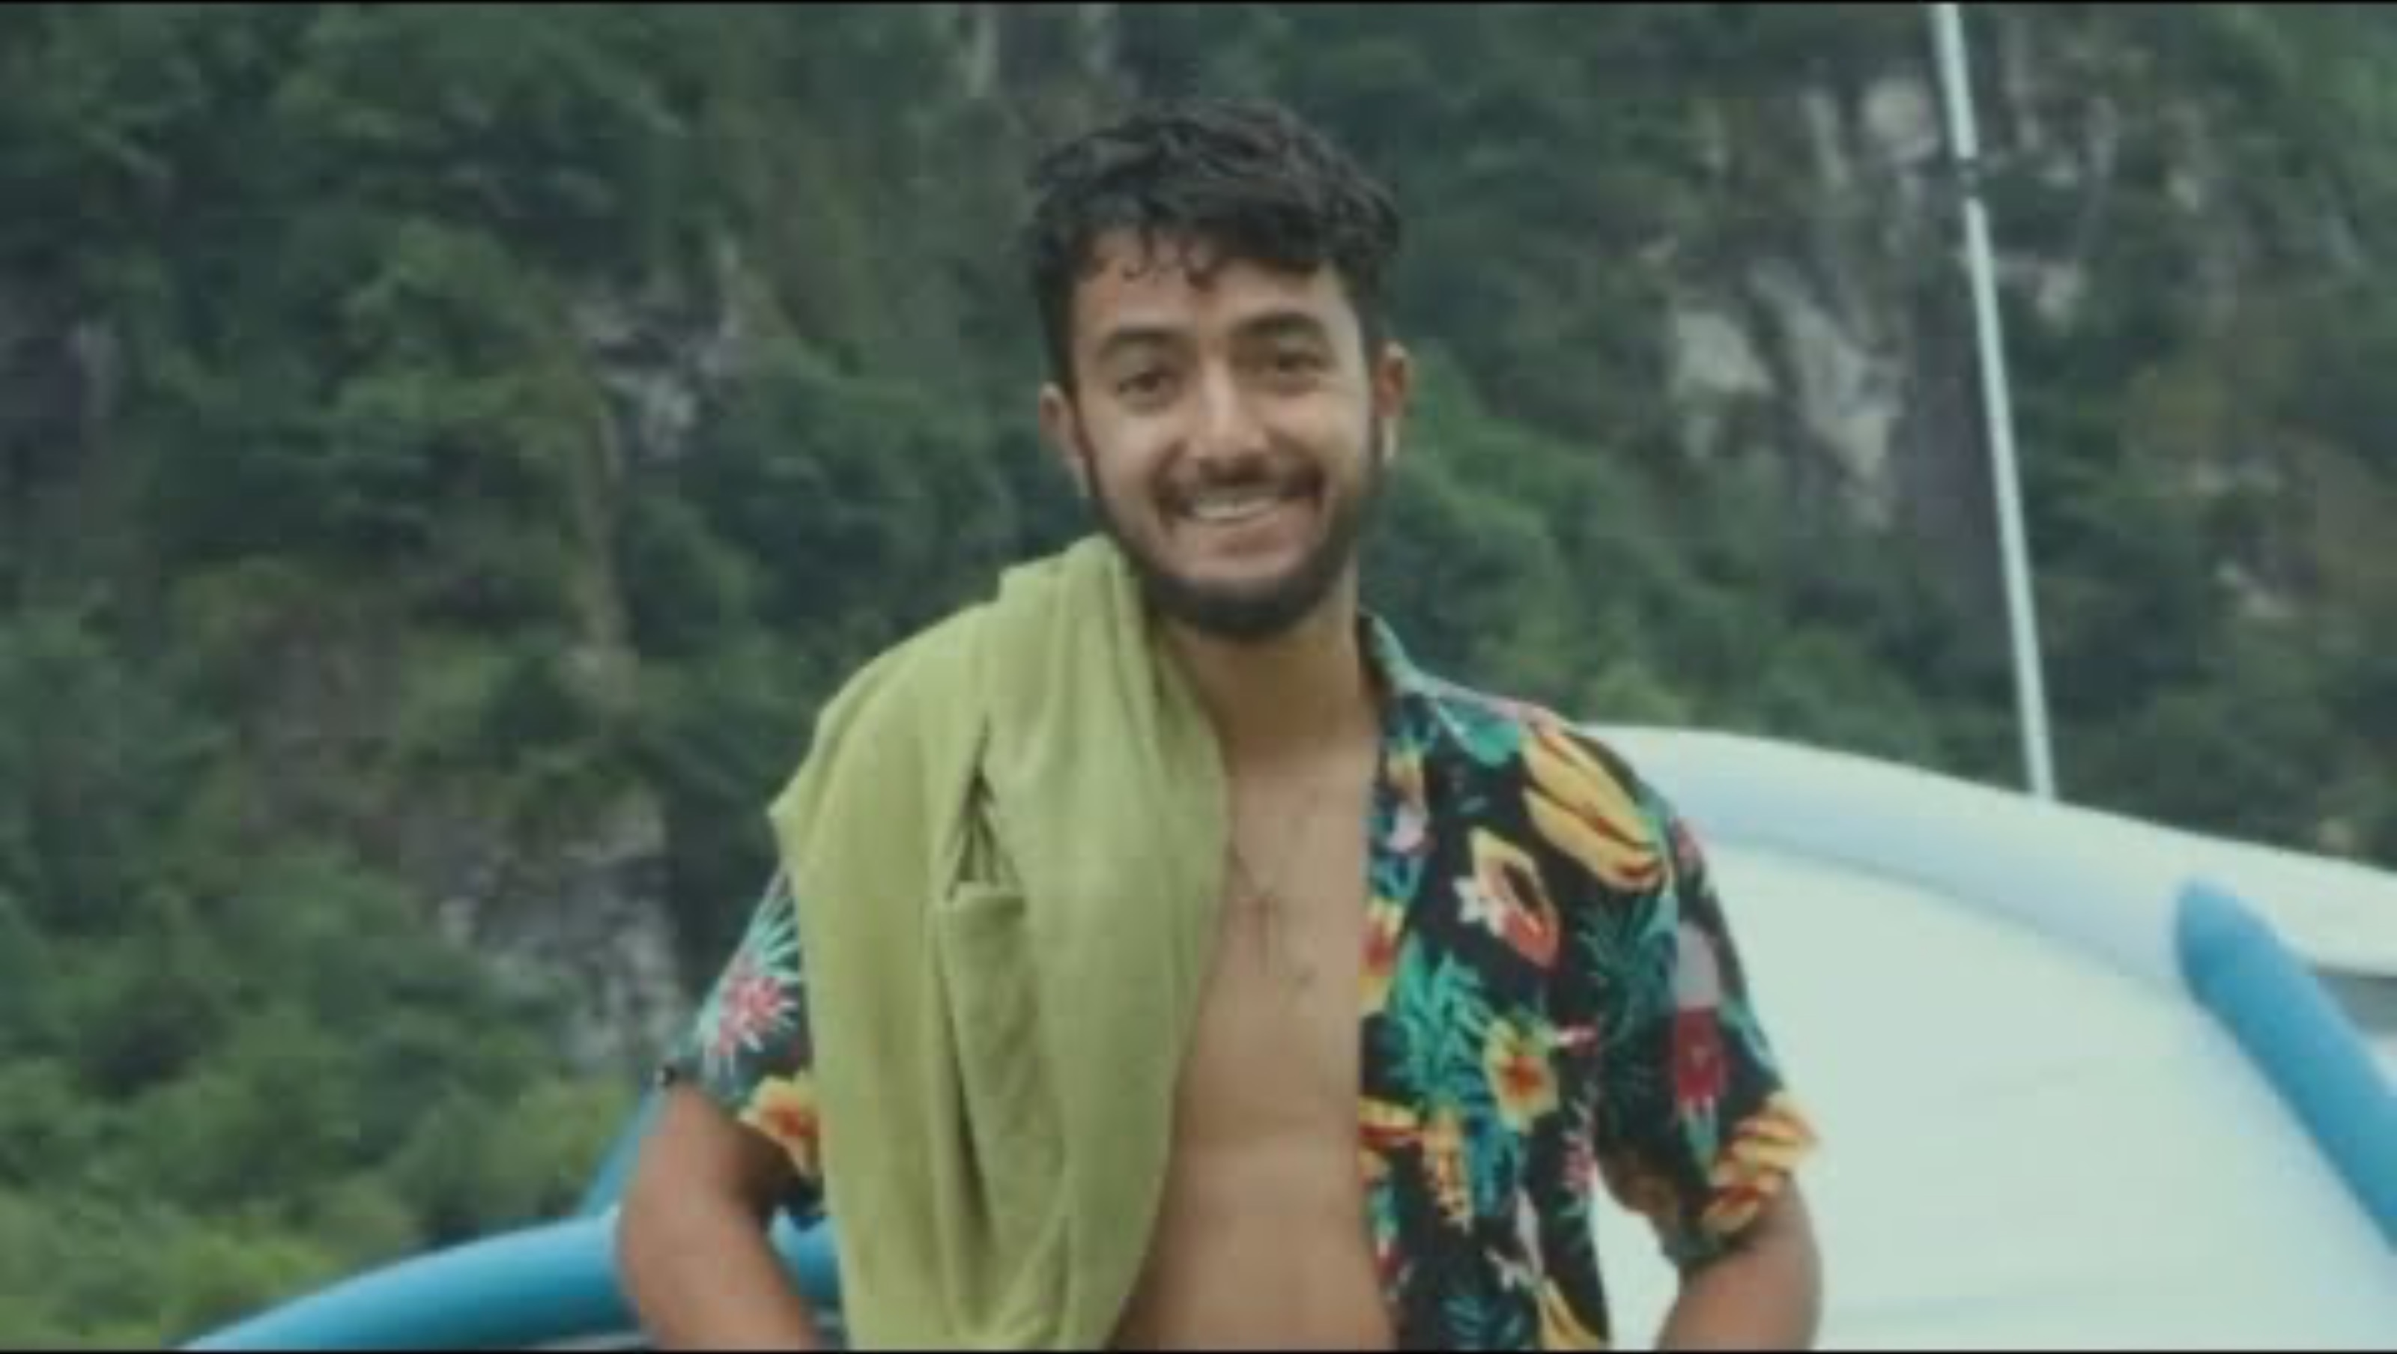
HERSH GOLDBERG-POLIN MURDERED BY HAMAS
FACES OF THE FESTIVAL
“MAY HIS MEMORY BE A REVOLUTION.”
Jonathan Polin,
Father of Hersh Goldberg-Polin

Slide 10
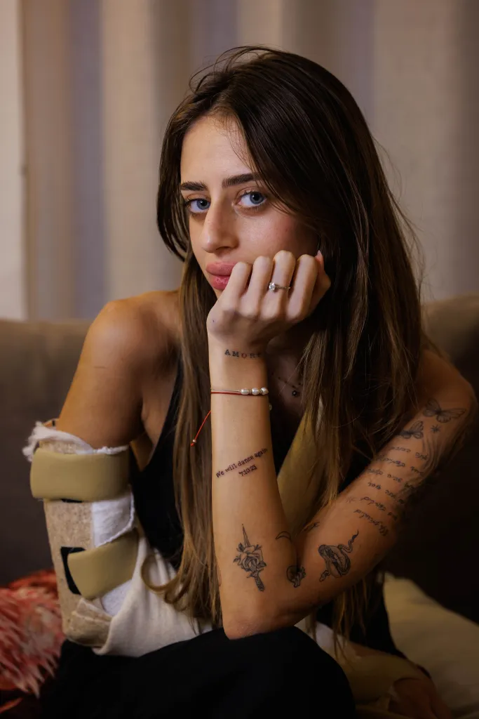
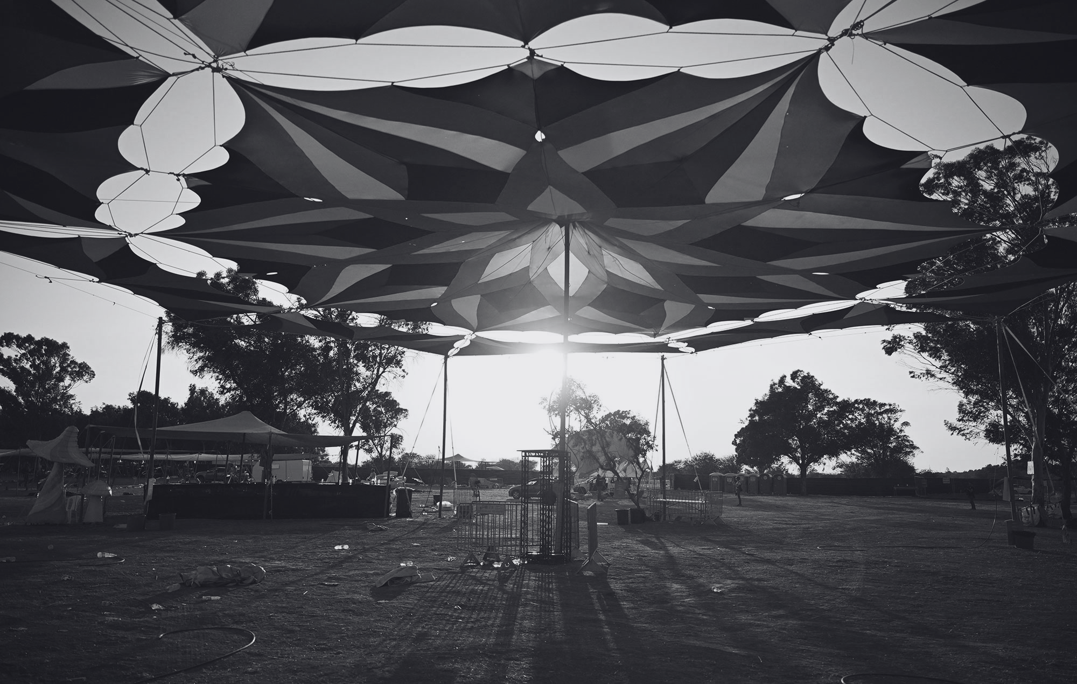
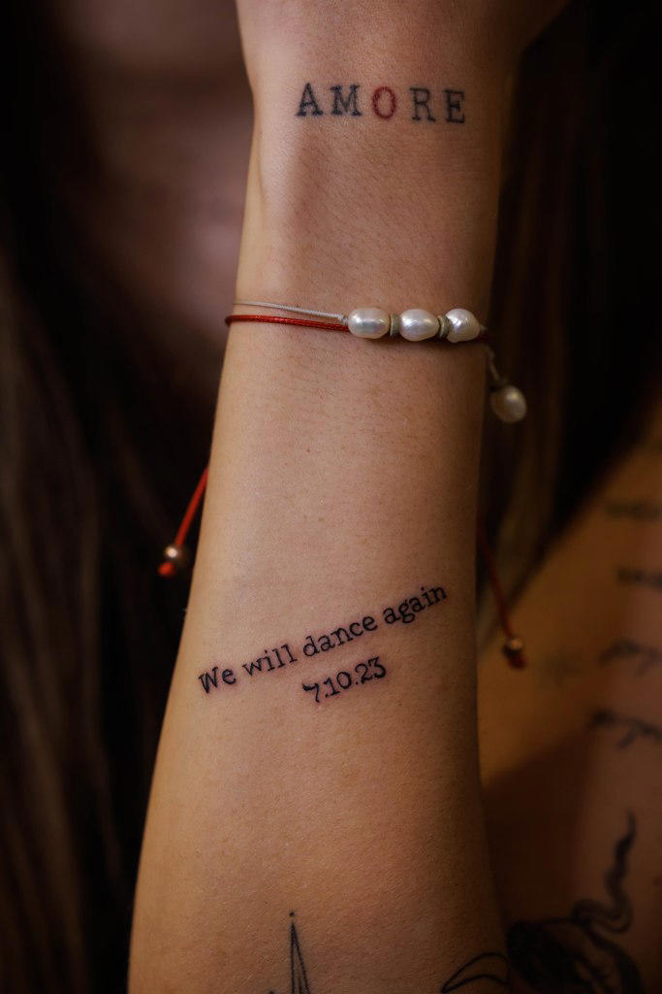
MIA SCHEM RELEASED BY HAMAS
FACES OF THE FESTIVAL
21-YEAR-OLD MIA SCHEM DISPLAYED HER RESILIANCE BY GETTING A TATTOO THAT READS “WE WILL DANCE AGAIN.”

Slide 11
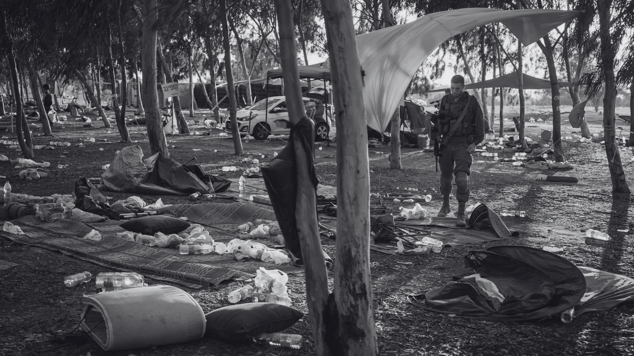
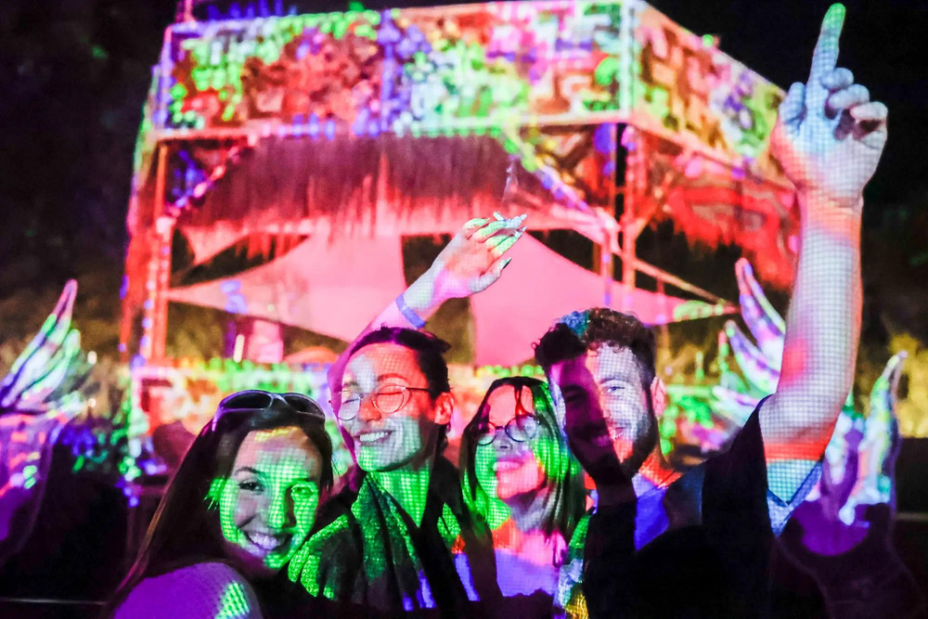



CONCLUSION
The Nova Music Festival massacre was perpetrated against innocent young people. Israel cannot stop until all the hostages are brought home.
FACES OF THE FESTIVAL
#NEVERAGAIN
#BRINGTHEMHOMENOW
#WEWILLDANCEAGAIN

